Slide 1
Expert Systems and Knowledge Engineering

Slide 2
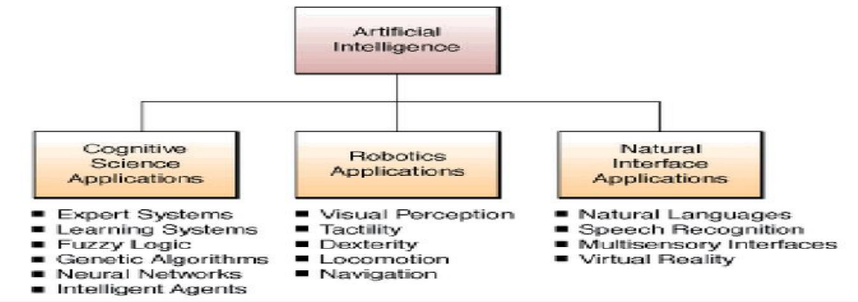
Background
Expert systems (ES) are systems that emanate from Artificial Intelligence (AI). AI is the branch of Computer Science concerned with developing computers that behaves like humans. Precisely, Expert systems occupy a central place in the cognitive science aspect of artificial intelligence as shown in figure 1.1 below.
Figure 1.1: Showing the place of expert system in the broad AI domain

Slide 3
History I
1943 Post production rules: McCulloch and Pitts Neuron model
1954 Markov algorithm for controlling rule execution
1956 Dartmouth conference
1957 Perceptron by Rosenblatt, GPS by Newell, Shaw & Simon
1958 LISP by McCarthy
1962 Rosenblatt's principle of neurodynamics
1965 Resolution for automated theorem proving by Robinson Fuzzy logic by Zadeh DENDRAL (1st ES) designed by Feigenbaum and Buchanan
1968 Semantic nets and associative memory by Quillian
1969 MACSYMA: expert system in mathematics by Martin and Moses
1970 PROLOG by Colmerauer and Roussel
1971 HEARSAY I (speech recognition)
1973 MYCIN (medicine) by Shortliffe and al., followed by GUIDON (tutoring) by Clancey TEIRESIAS (explanation) by Davis EMYCIN (shell) by Van Melle, Shortliffe and Buchanan HEARSAY II (blackboard: multiple expert cooperation)

Slide 4
History II
1975 Frames by Minsky
1976 AM (artificial Math.):creative discovery of math concepts by Lenat Dempster-Shafer theory of evidence for reasoning under uncertainty PROSPECTOR (mineral exploration) by Duda and Hart
1977 OPS expert system Shell by Forgy, used in XCON/R1
1978 XCON/R1 (DEC compzter config.) by McDermott Meta-Dendral (meta-rules and -induction) by Buchanan
1979 Rete algorithm for efficient pattern matching AI becomes commercial Inference Corp. Formed (releases ART expert system in 85)
1980 Symbolics (-> LISP machines)
1982 SMP math expert system Hopfield neural net Fifth generation project in Japan
1983 KEE expert system tool by Intellicorp
1985 CLIPS expert system tool by NASA

Slide 5
History III
Expert systems are now in commercial and research use in a number of fields:
KAS (Knowledge Acquisition System) and Teiresias help knowledge engineers build expert systems.
ONCOCIN assists physicians in managing complex drug regimens for treating cancer patients.
Molgen helps molecular biologists in planning DNA experiments.
Guidon is an education expert that teaches students by correcting answers to technical questions.
Genesis assists scientists in planning cloning experiments.
TATR is used by the Air Force in planning attacks on enemy air bases.

Slide 6
What is an expert system?
“An expert system is a computer system that emulates, or acts in all respects, with the decision-making capabilities of a human expert.”
Professor Edward Feigenbaum

Slide 7
An expert system belongs to a field of artificial intelligence, and it is a computer program that simulates the judgment and behavior of an individual that has expert knowledge and experience in a particular field. It is a knowledge-based computer program that exhibits a degree of expertise in a particular domain thereby solving problem or making decisions that is comparable to that of a human expert.
It could also be referred to as an AI programs that achieve expert-level competence in solving problems in task areas by bringing to bear a body of knowledge about specific tasks. It could be referred to as knowledge-based or expert systems

Slide 8
A type of application program that makes decisions or solves problems in a particular field by using knowledge and analytical rules defined by experts in the field.
It is a branch of artificial intelligence, aiming to take the experience of human specialists and to transfer to a computer system. Specialty knowledge is stored in the computer, which by an execution system (inference engine) is reasoning & it derives specific conclusions for the problem.
A computer program that uses knowledge and reasoning techniques to solve problems that normally require the abilities of human experts. Software that applies human-like reasoning involving rules and heuristics to solve a problem.

Slide 9
An Expert System (EPS) is a software system, which finds solutions on the basis of expert knowledge or provides an evaluation of known problems. Examples are systems for the support of medical diagnosis or for the analysis of scientific data.
Is a particular development of Artificial intelligence that helps to solve problems or make decisions through the use of a store of relevant Information (known as the Knowledge base, and derived from one or more human experts), and a set of reasoning techniques.
Artificial intelligence based system that converts the knowledge of an expert in a specific subject into a software code. This code can be merged with other such codes (based on the knowledge of other experts) and used for answering questions (queries) submitted through a computer.

Slide 10
Despite the above definitions of Expert systems by different authors, it is important to summarize that an expert system is a knowledge-based computer program that exhibits, within a specific domain, a degree of expertise in problem solving that is comparable to that of a human expert. This problem method uses a knowledge base, which is carefully formulated on the basis of expert judgment, intuition, and experience. Thus an expert system embodies the cognition and ability of an expert in a certain realm, thus emulating the decision-making ability of a human.
The term expert system is reserved for programs whose knowledge base contains the knowledge used by human experts, in contrast to knowledge gathered from textbooks or non-experts.

Slide 11
The two terms, expert systems (ES) = knowledge-based systems (KBS),. The area of human intellectual endeavor to be captured in an expert system is called the task domain. Task refers to some goal-oriented, problem-solving activity. Domain refers to the area within which the task is being performed. Typical tasks are diagnosis, planning, scheduling, configuration and design. An example of a task domain is aircraft crew scheduling.
In most cases, the purpose of the expert systems is to help and support users reasoning and not to replace human expert judgment. In fact, expert systems offer to the inexperienced user a solution when human experts are not available.
Expert system is a subset of intelligent systems design under AI, however, expert and intelligence are not the same thing. Let us try to differentiate between intelligence and expertise with a view to uncovering the focal area of expert system in the broad discussions of intelligent systems

Slide 12
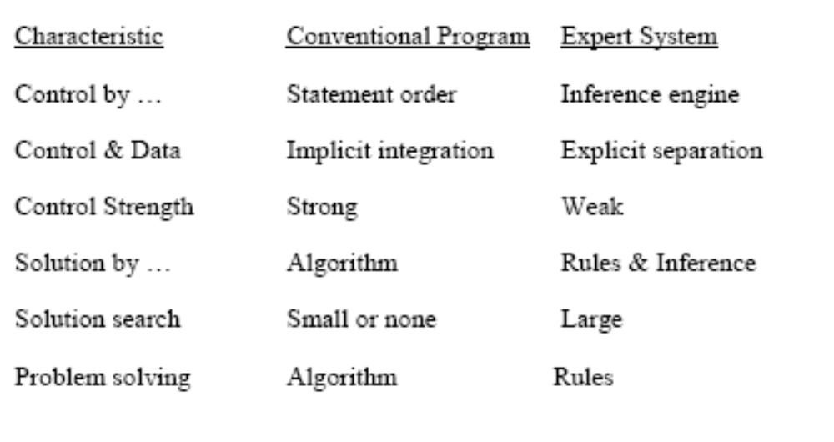
Expert systems Vs conventional programs I

Slide 13
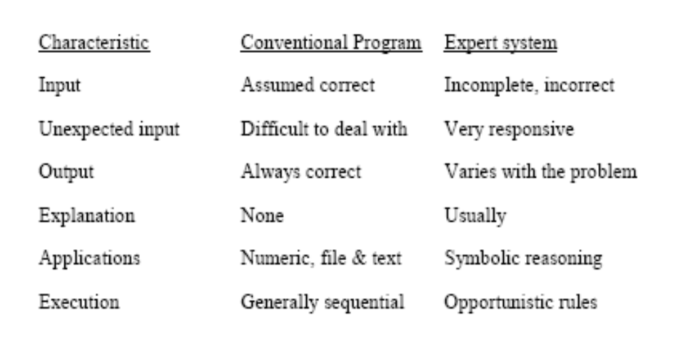
Expert systems Vs conventional programs II

Slide 14
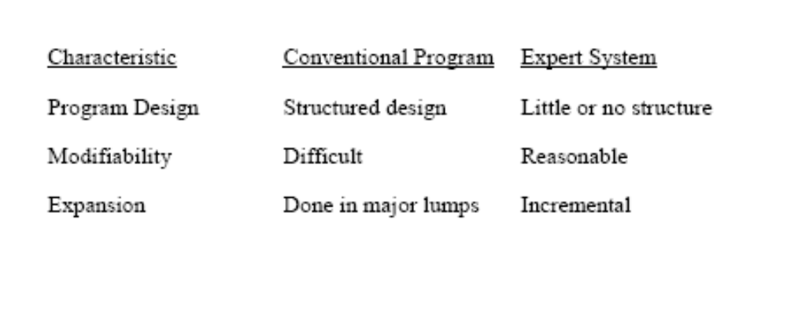
Expert systems Vs conventional programs III

Slide 15
Expert System Main Components
Knowledge base – obtainable from books, magazines, knowledgeable persons, etc.
Inference engine – draws conclusions from the knowledge base

Slide 16
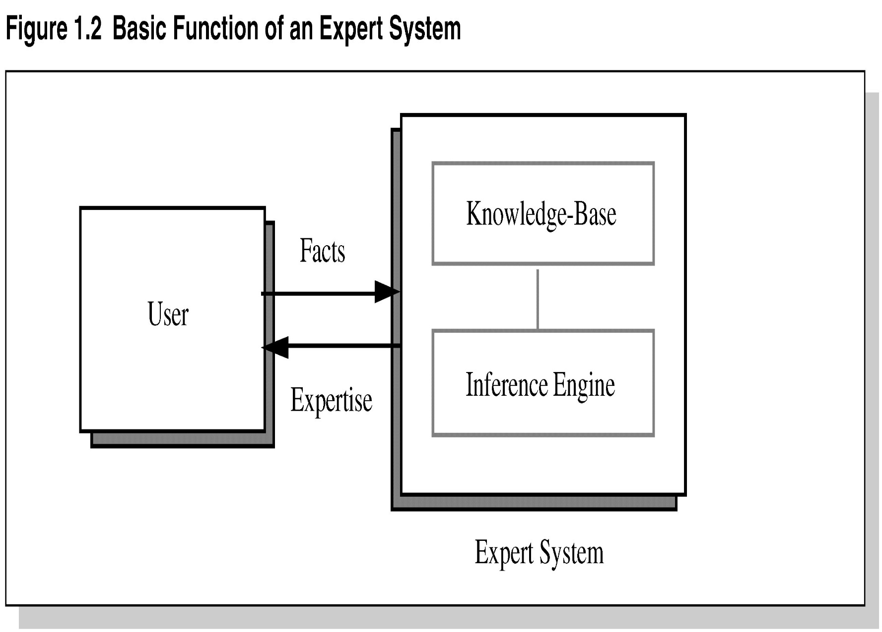
Figure 1.2 Basic Functions of Expert Systems

Slide 17
Problem Domain vs. Knowledge Domain
An expert’s knowledge is specific to one problem domain – medicine, finance, science, engineering, etc.
The expert’s knowledge about solving specific problems is called the knowledge domain.
The problem domain is always a superset of the knowledge domain.

Slide 18
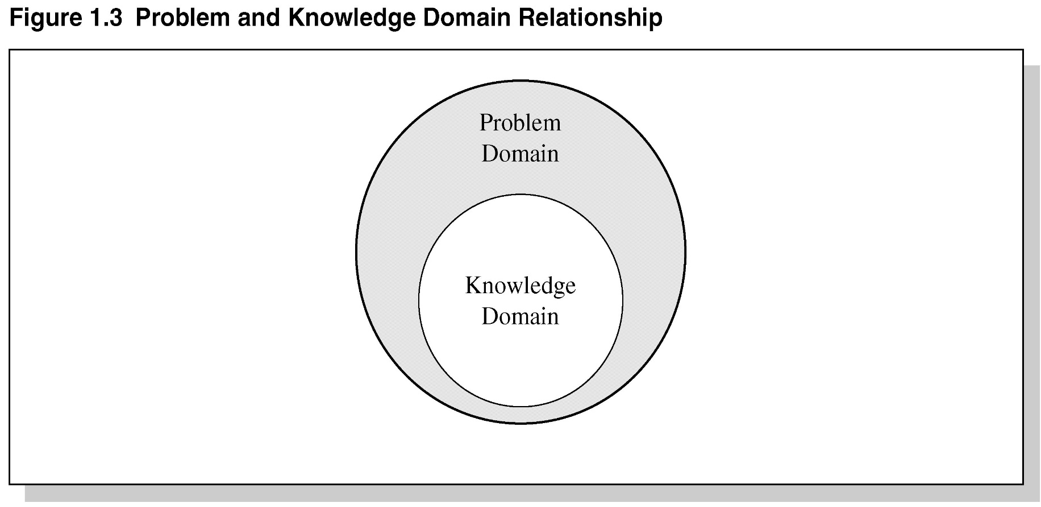
Figure 1.3 Problem and Knowledge Domain Relationship

Slide 19
Representing the Knowledge
The knowledge of an expert system can be represented in a number of ways, including IF-THEN rules:
IF you are hungry THEN eat

Slide 20
Knowledge Engineering
The process of building an expert system:
The knowledge engineer establishes a dialog with the human expert to elicit knowledge.
The knowledge engineer codes the knowledge explicitly in the knowledge base.
The expert evaluates the expert system and gives a critique to the knowledge engineer.

Slide 21
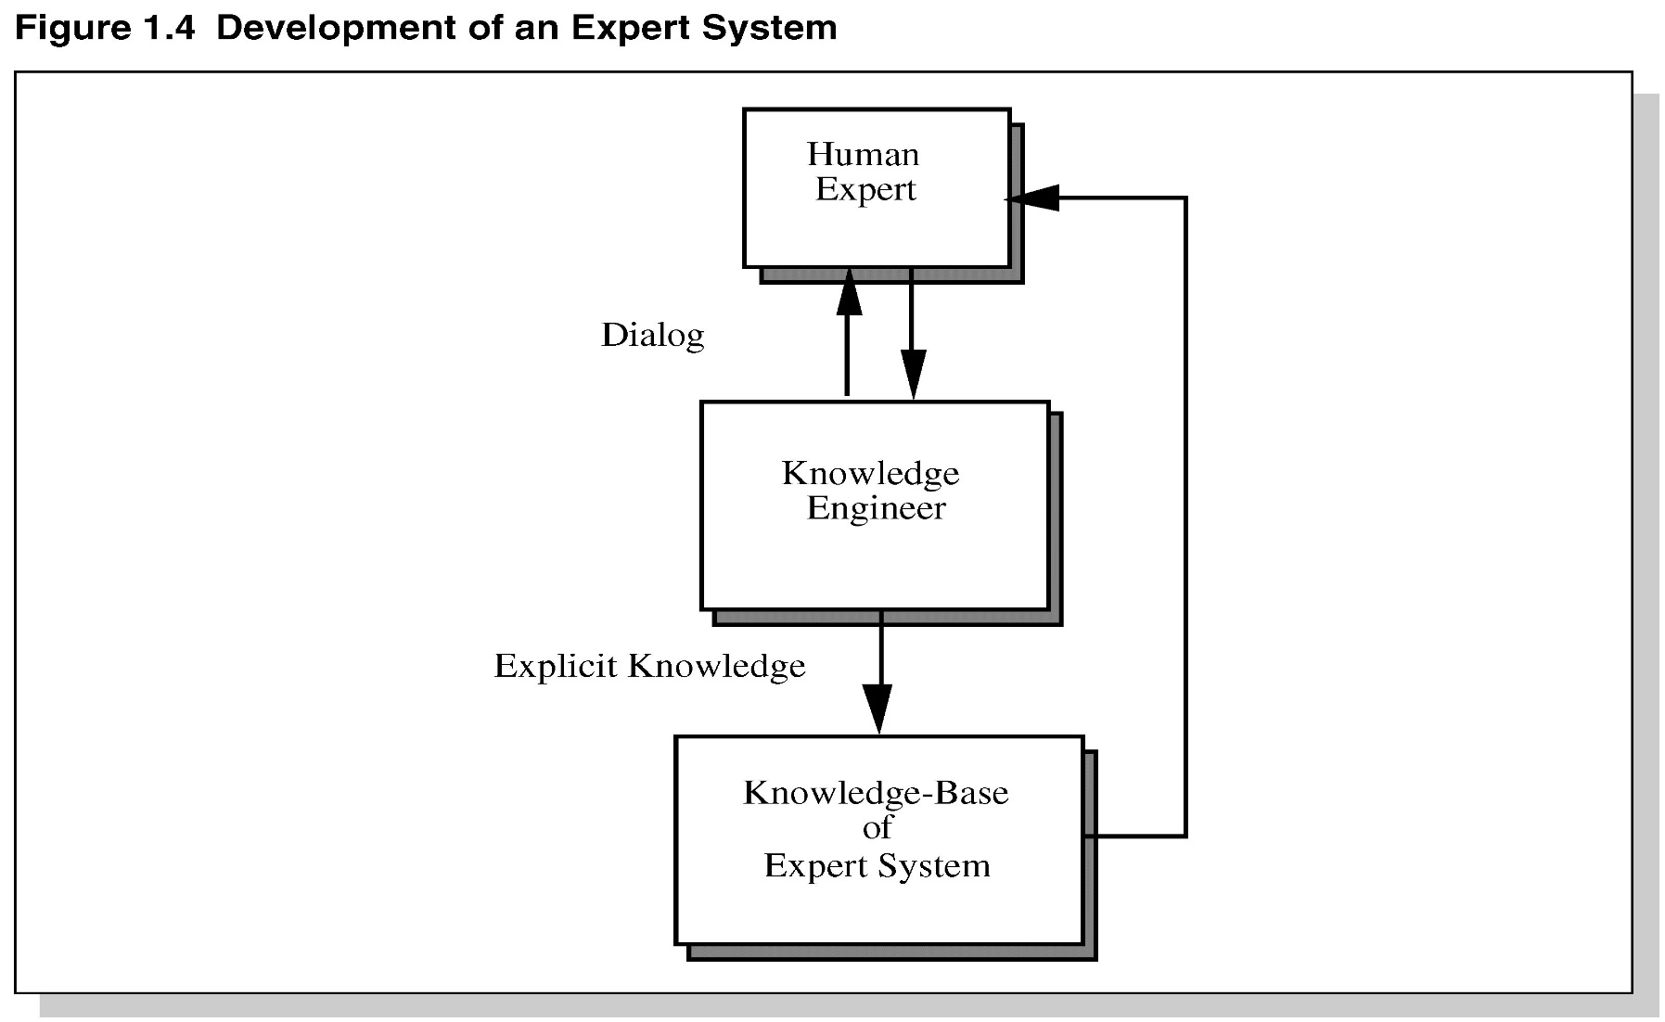
Development of an Expert System

Slide 22
The Role of AI
An algorithm is an ideal solution guaranteed to yield a solution in a finite amount of time.
When an algorithm is not available or is insufficient, we rely on artificial intelligence (AI).
Expert system relies on inference – we accept a “reasonable solution.”

Slide 23
Shallow and Deep Knowledge
It is easier to program expert systems with shallow knowledge than with deep knowledge.
Shallow knowledge – based on empirical and heuristic knowledge.
Deep knowledge – based on basic structure, function, and behavior of objects.

Slide 24
Early Expert Systems
DENDRAL – used in chemical mass spectroscopy to identify chemical constituents
MYCIN – medical diagnosis of illness
DIPMETER – geological data analysis for oil
PROSPECTOR – geological data analysis for minerals
XCON/R1 – configuring computer systems

Slide 25
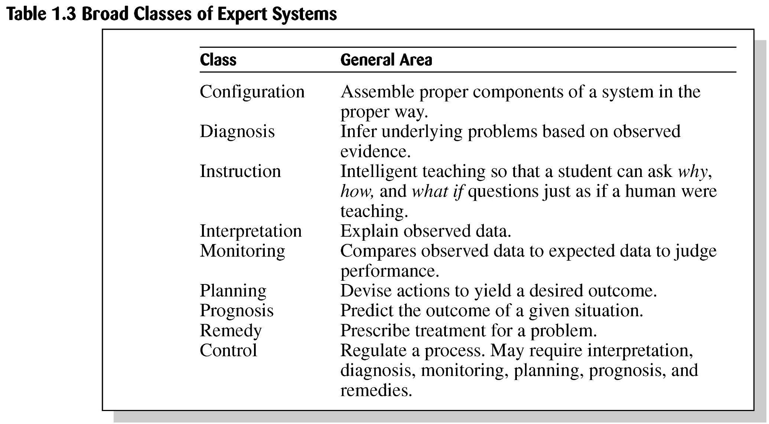
Table 1.3 Broad Classes of Expert Systems

Slide 26
Problems with Algorithmic Solutions
Conventional computer programs generally solve problems having algorithmic solutions.
Algorithmic languages include C, Java, and C#.
Classic AI languages include LISP and PROLOG.

Slide 27
Considerations for Building Expert Systems
Can the problem be solved effectively by conventional programming?
Is there a need and a desire for an expert system?
Is there at least one human expert who is willing to cooperate?
Can the expert explain the knowledge to the knowledge engineer can understand it.
Is the problem-solving knowledge mainly heuristic and uncertain?

Slide 28
Languages, Shells, and Tools
Expert system languages are post-third generation.
Procedural languages (e.g., C) focus on techniques to represent data.
More modern languages (e.g., Java) focus on data abstraction.
Expert system languages (e.g. CLIPS) focus on ways to represent knowledge.

Slide 29
Elements of an Expert System I
User interface – mechanism by which user and system communicate.
Exploration facility – explains reasoning of expert system to user.
Working memory – global database of facts used by rules.
Inference engine – makes inferences deciding which rules are satisfied and prioritizing.

Slide 30
Elements of an Expert System II
Agenda – a prioritized list of rules created by the inference engine, whose patterns are satisfied by facts or objects in working memory.
Knowledge acquisition facility – automatic way for the user to enter knowledge in the system bypassing the explicit coding by knowledge engineer.
Knowledge Base – includes the rules of the expert system

Slide 31
Production Rules
Knowledge base is also called production memory.
Production rules can be expressed in IF-THEN pseudocode format.
In rule-based systems, the inference engine determines which rule antecedents are satisfied by the facts.

Slide 32
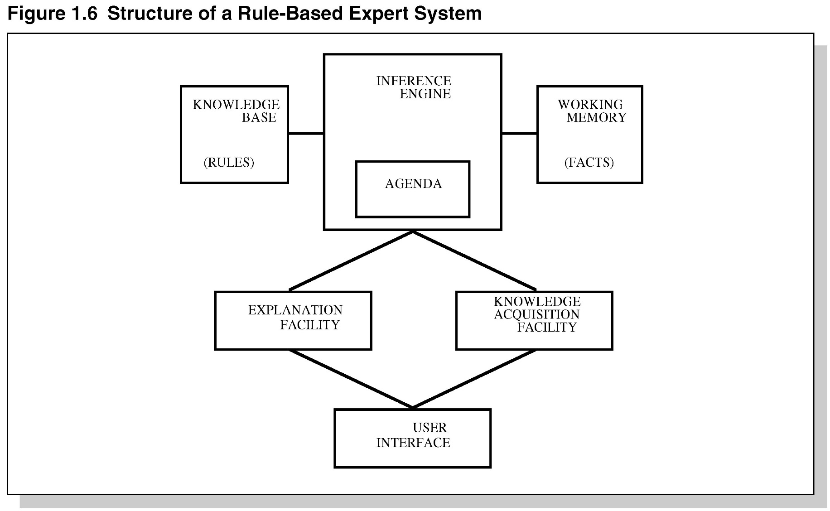
Figure 1.6 Structure of a
Rule-Based Expert System

Slide 33
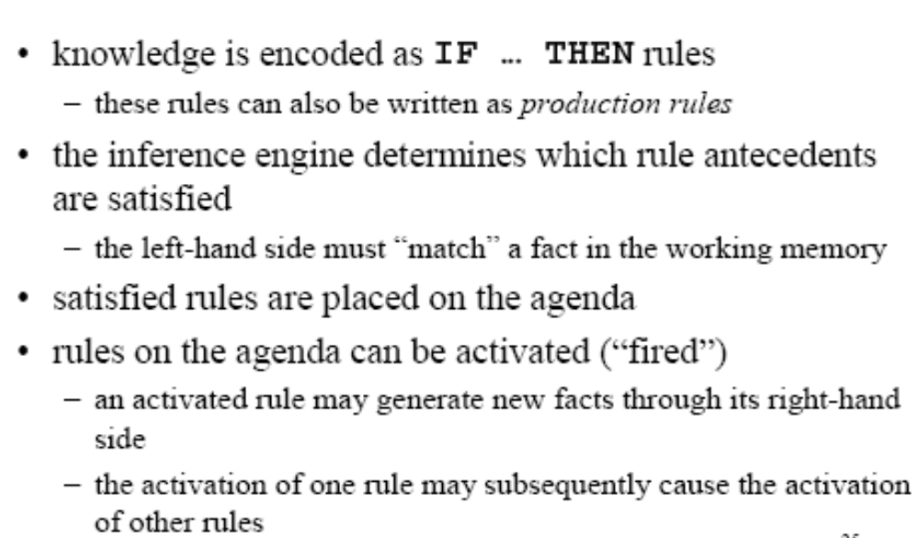
Rule-Based ES

Slide 34
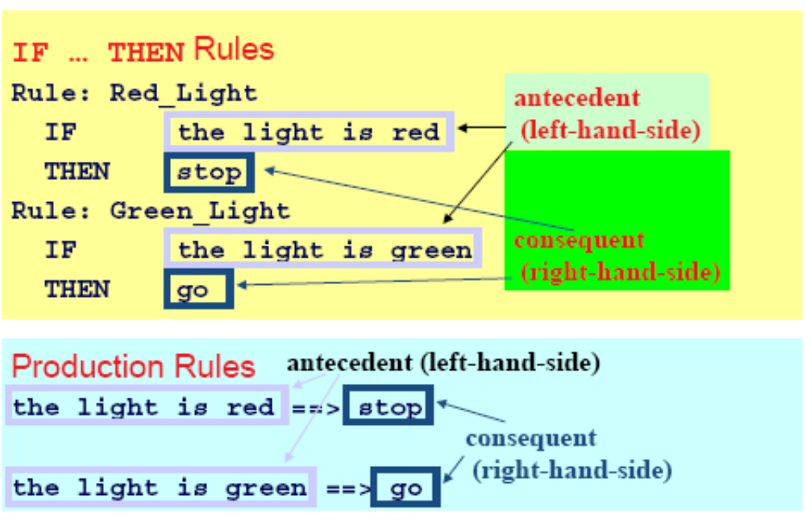
Example Rules

Slide 35
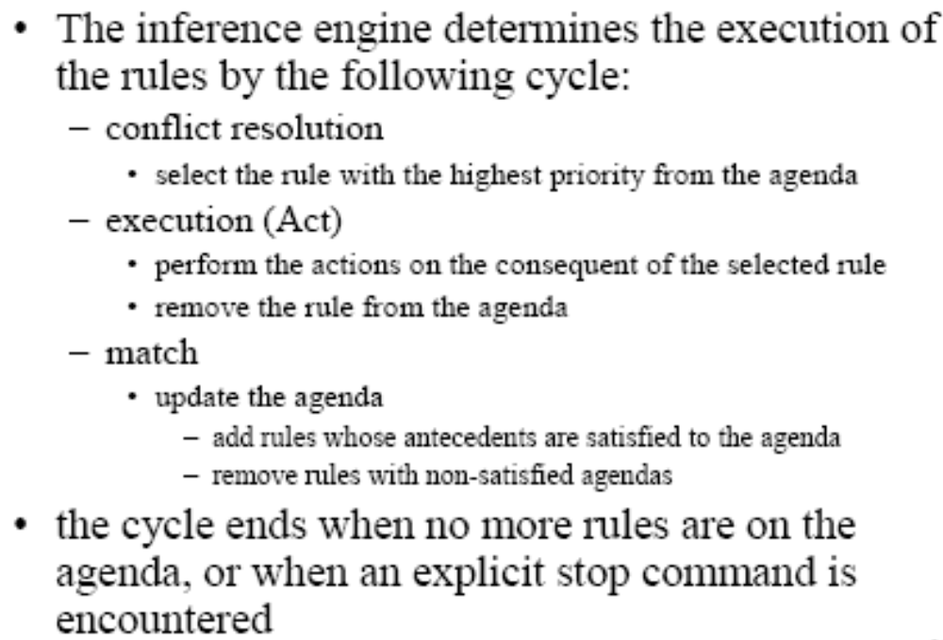
Inference Engine Cycle

Slide 36
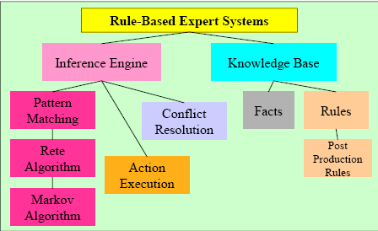
Foundation of Expert Systems

Slide 37
General Methods of Inferencing
Forward chaining (data-driven)– reasoning from facts to the conclusions resulting from those facts – best for prognosis, monitoring, and control.
  Examples: CLIPS, OPS5
Backward chaining (query driven)– reasoning in reverse from a hypothesis, a potential conclusion to be proved to the facts that support the hypothesis – best for diagnosis problems.
  Examples: MYCIN

Slide 38
Features of Expert Systems I
Operates as an interactive system. This means an expert system :
  Responds to questions - Asks for clarifications
  Makes recommendations - Aids the decision-making process.
Tools have ability to sift (filter) knowledge
  Storage and retrieval of knowledge
  Mechanisms to expand and update knowledge base on a continuing basis.
Make logical inferences based on knowledge stored
  Simple reasoning mechanisms is used
  Knowledge base must have means of exploiting the knowledge stored, else it is useless; e.g., learning all the words in a language, without knowing how to combine those words to form a meaningful sentence.
Ability to Explain Reasoning
  Remembers logical chain of reasoning; therefore user may ask
  1. for explanation of a recommendation -2. factors considered in recommendation
Enhances user confidence in recommendation and acceptance of expert system

Slide 39
Features of Expert Systems II
Domain-Specific
  A particular system caters a narrow area of specialization; e.g., a medical expert system
  Quality of advice offered by an expert system is dependent on the amount of knowledge
Capability to assign Confidence Values
  Can deliver quantitative information -Can interpret qualitatively derived values
  Can address imprecise and incomplete data through assignment of confidence values.
Cost-Effective alternative to Human Expert
  Expert systems have become increasingly popular because of their specialization, albeit in a narrow field.
  Encoding and storing the domain-specific knowledge is economic process due to small size.
  Specialists in many areas are rare and the cost of consulting them is high; an expert system of those areas can be useful and cost-effective alternative in the long run.
Goal Driven Reasoning or Backward Chaining
  An inference technique which uses IF-THEN rules to repetitively break a goal into smaller sub-goals which are easier to prove;

Slide 40
Features of Expert Systems III
Coping with Uncertainty
  The ability of the system to reason with rules and data which decision to make. Often the Knowledge is imperfect which causes uncertainty. To work in the real world, Expert systems must be able to deal with uncertainty.
    One simple way is to associate a numeric value with each piece of information in the system.
    the numeric value represents the certainty with which the information is known.
Data Driven Reasoning or Forward Chaining
  An inference technique which uses IF-THEN rules to deduce a problem solution from initial data;
Data Representation
  Data representation is the way in which the problem specific data in the system is stored and accessed. Expert system is built around a knowledge base module.
    Knowledge acquisition is transferring knowledge from human expert to computer.
    Knowledge representation is faithful representation of what the expert knows.
User Interface
  The user interface is the portion of the system which creates an intermediary between the system and the user for interaction. The acceptability of an expert system depends largely on the quality of the user interface.
    Scrolling dialog interface: It is easiest to implement and communicate with the user.
    Pop-up menus, windows, mice are more advanced interfaces and powerful tools for communicating with the user; they provide graphic support.

Slide 41
Advantages of Expert Systems I
Permanence: Expert systems do not forget.
Reproducibility: Copies of an expert system can be made.
Power: For applications where there is a maze of rules exhibited, it can be unraveled by the expert system.
Efficiency: Expert systems can increase throughput and reduce personnel costs.
  Expert systems are inexpensive to operate.
  Development costs can be amortized over many years.
  It can eliminate routine costs & reduce major maintenance costs.
Consistency: With expert systems, similar events are handled the same way. Expert systems will make comparable recommendations for 'like' situations and are not affected by recent or primary effects.
Documentation: Expert systems provide permanent documentation of the decision process.

Slide 42
Advantages of Expert Systems II
Completeness: An expert system can review all the transactions or possibilities.
Timeliness: Fraud and/or errors can be prevented. Information is available sooner for decision making and action. The expert system works 24 hours a day, all year long.
Scope: The expert system can encompass the cumulative expertise of many human experts.
Business success: Owners reduce the inherent risks of conducting their business due to:
  Consistency of decision making. - Documentation (ISO requirements)
  Acquired expertise
Positive impacts:
  Productivity gains and cost savings.
  Critical new tool for managers and a proactive answer to expertise attrition.
  Decisions and solutions are more consistent and less subject to biases or sensitivity to the environment
  Employment: shift to-wards more satisfying work.

Slide 43
Disadvantages of Expert Systems
Common sense: In addition to a great deal of technical knowledge, human experts have commonsense. It is not yet known how to give expert systems common sense.
Creativity: Human experts can respond creatively to unusual situations, expert systems cannot.
Learning: Human experts automatically adapt to changing environments; expert systems must explicitly update. Case-based reasoning and neural networks are methods that can incorporate learning.
Sensory experience: Human experts have available to them a wide range of sensory experience; expert systems are currently dependent on symbolic input.
Degradation: Expert systems are not good at recognizing when no answer exists or when the problem is outside their area of expertise.

